Slide 1
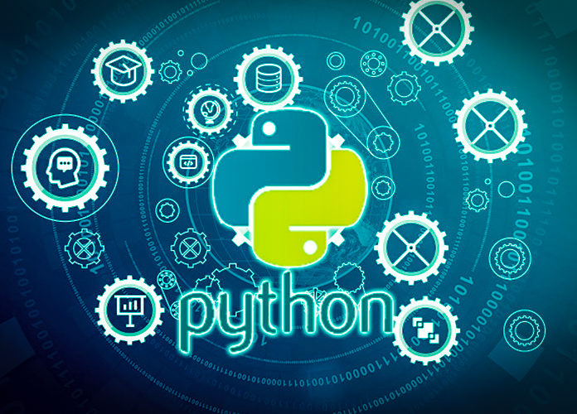
Data Programming in Python _________________ Introduction to Python

Slide 2

Python as a Programming Language
General purpose and high-level
Web development
Data analysis and artificial intelligence
Scientific computing and networking
Written in a form close to human language

Slide 3
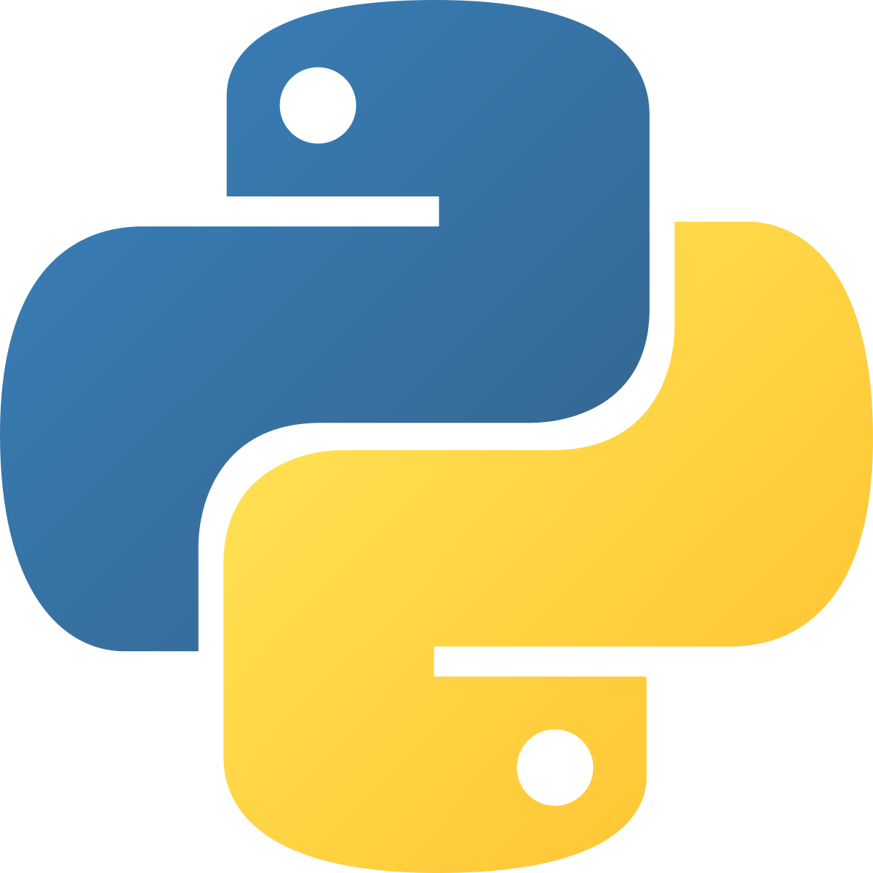
Benefits of Python
Intuitive to Understand & Learn
Readable and flexible code
Easy integration with apps
Open access external libraries
Extensive help and AI

Slide 4
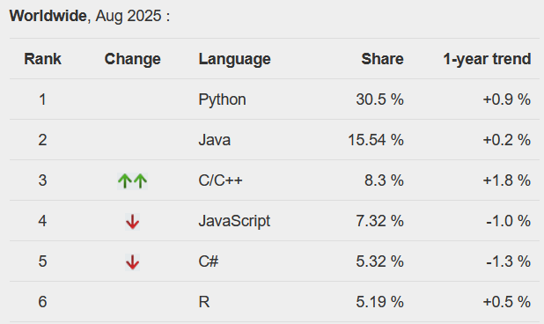
Worldwide Use
Most popular programming language
https://pypl.github.io/PYPL.html

Slide 5
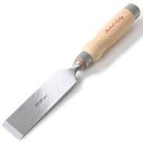

Python as a Tool
Python is a data science tool
Used to build models & analysis

Slide 6
Programming in Python
Course Outline
Intro to Using Python & Jupyter
Data Types and Collections
Functions
Flow Control and Loops
File Handling
Dataframes (Pandas and NumPy)
Visualization (Matplotlib)
Machine Learning (Scikit-learn)

